Slide 1
NumPy
Dr. Dongchul Kim

Slide 2
Numpy
NumPy is a Python package for general-purpose array-processing. It provides a high-performance multidimensional array object, and tools for working with these arrays.
It is the fundamental package for scientific computing with Python. It contains various features but the most important feature is vectorization.
The vectorization results in more “Pythonic” code. Without vectorization, our code would be littered with inefficient and difficult to read for loops.

Slide 3
Numpy
Vectorization describes the absence of any explicit looping, indexing, etc., in the code - these things are taking place, of course, just “behind the scenes” in optimized, pre-compiled C code. Vectorized code has many advantages, among which are:
vectorized code is more concise and easier to read
fewer lines of code generally means fewer bugs
the code more closely resembles standard mathematical notation (making it easier, typically, to correctly code mathematical constructs)

Slide 4
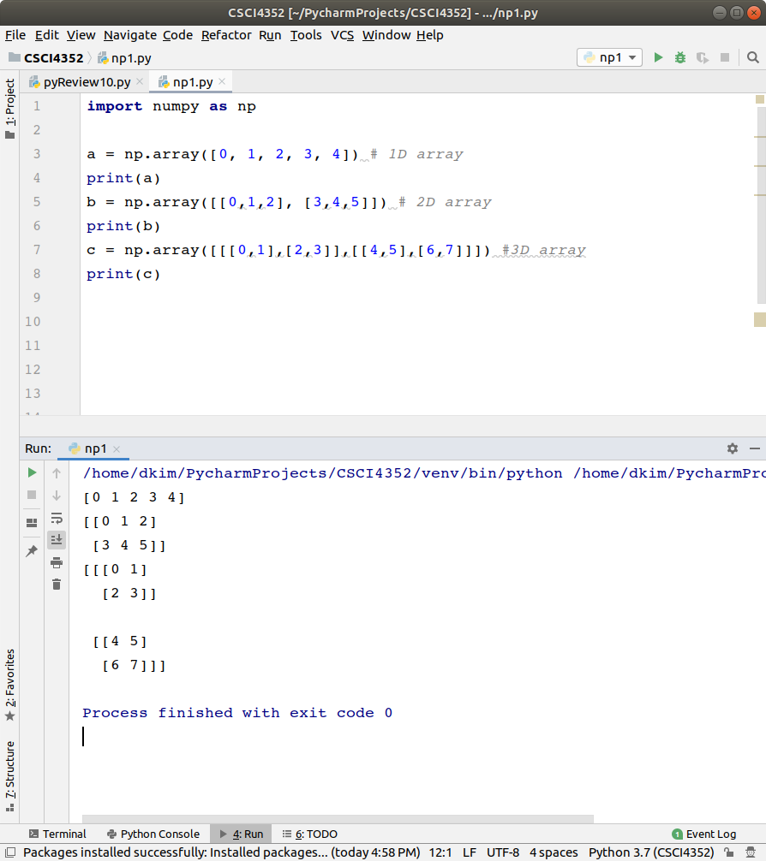
np.array()

Slide 5
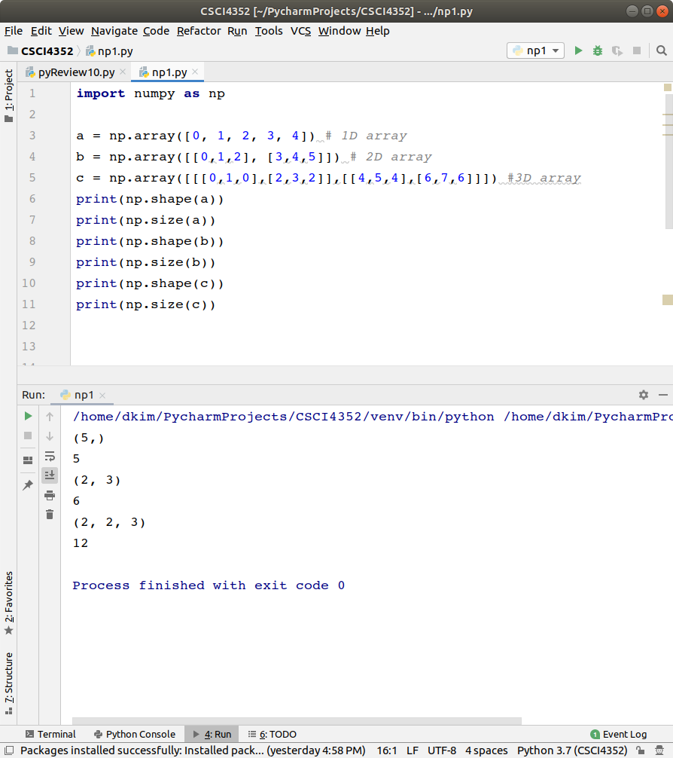
np.shape()
np.size()

Slide 6
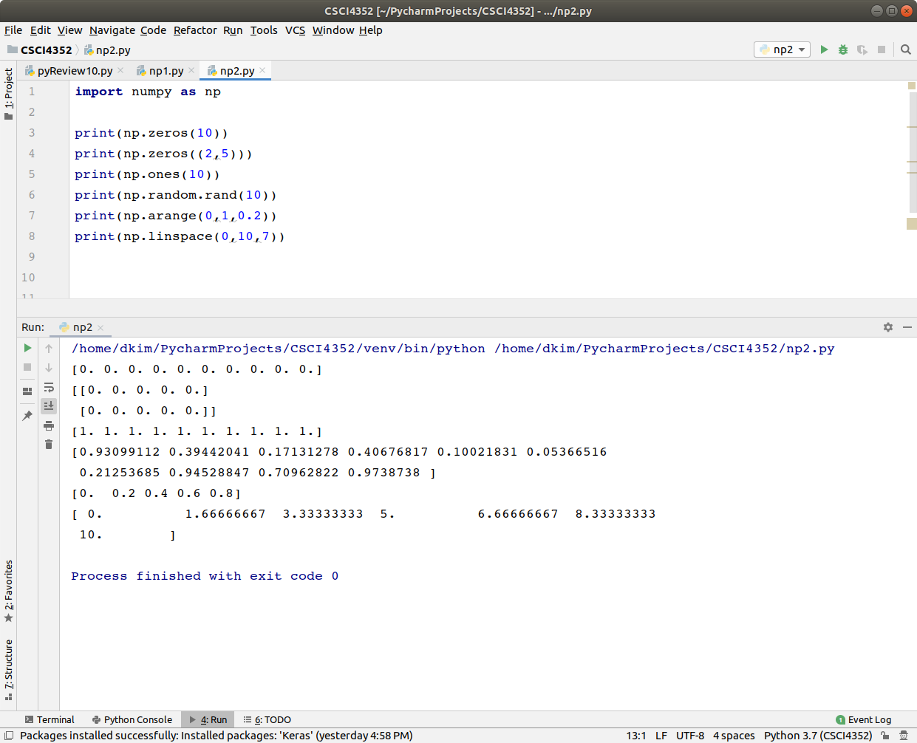
np.zeros()
np.ones()
np.random.rand()
np.arange()
np.linspace()

Slide 7
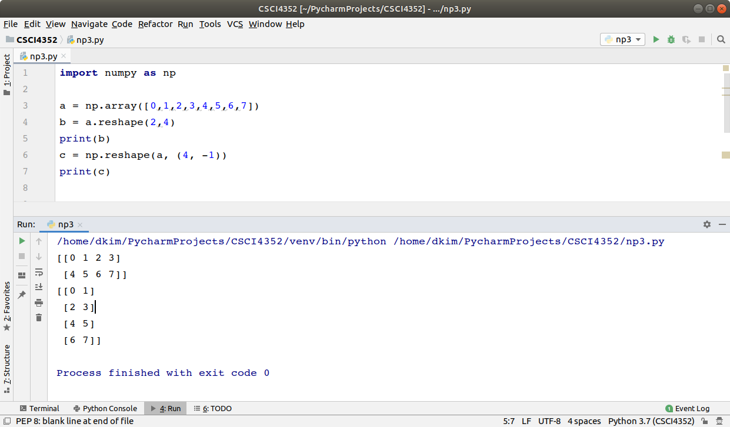
reshape()

Slide 8
Addition of two vectors (1D array)
Scalar product
A+B = [a₁, a₂]⏉+ [b₁, b₂]⏉ = [a₁+b₁, a₂+b₂]⏉
A ∙ c = [a₁, a₂]⏉ ∙ c = [a₁∙c, a₂∙c]⏉

Slide 9
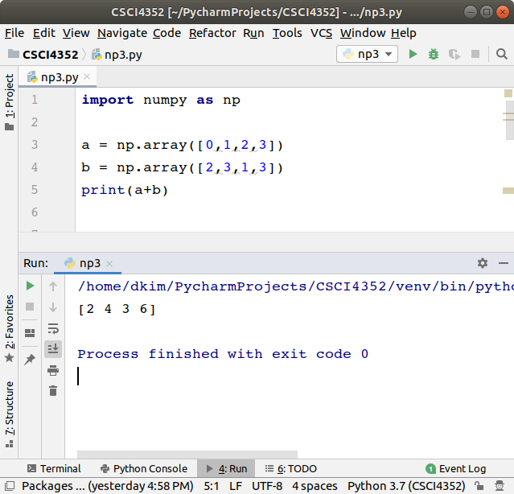
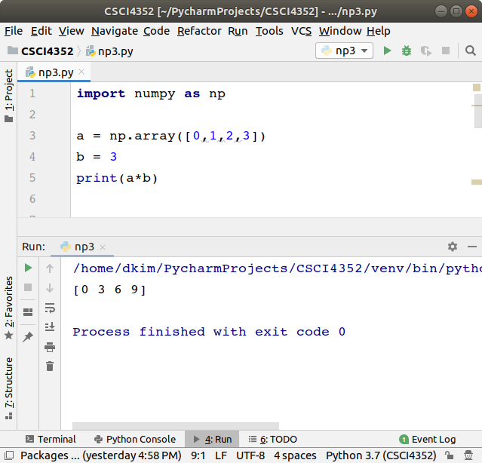

Slide 10
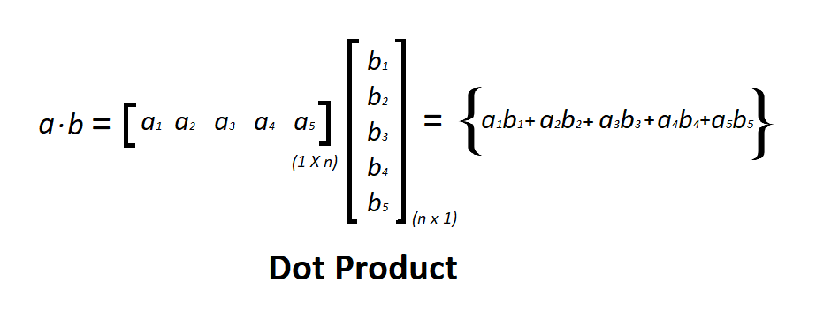
Dot product

Slide 11
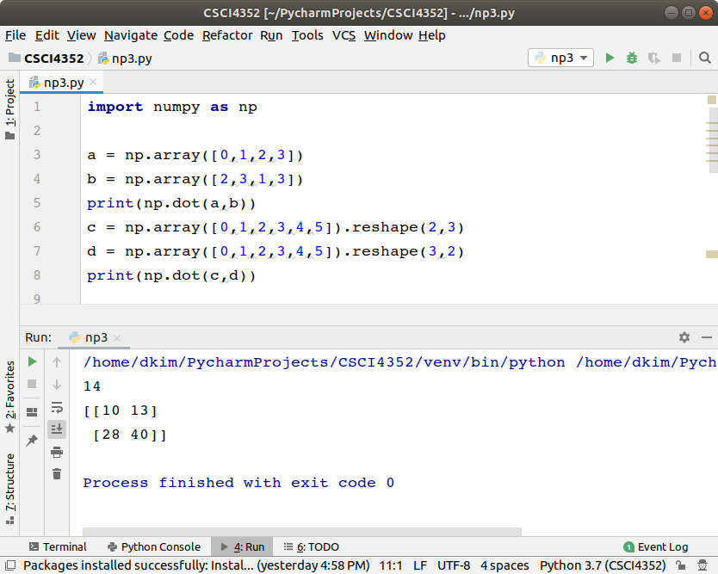

Slide 12
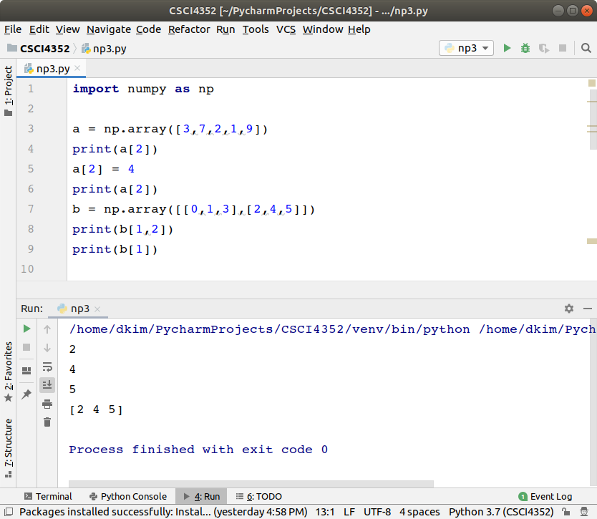
Access to elements

Slide 13
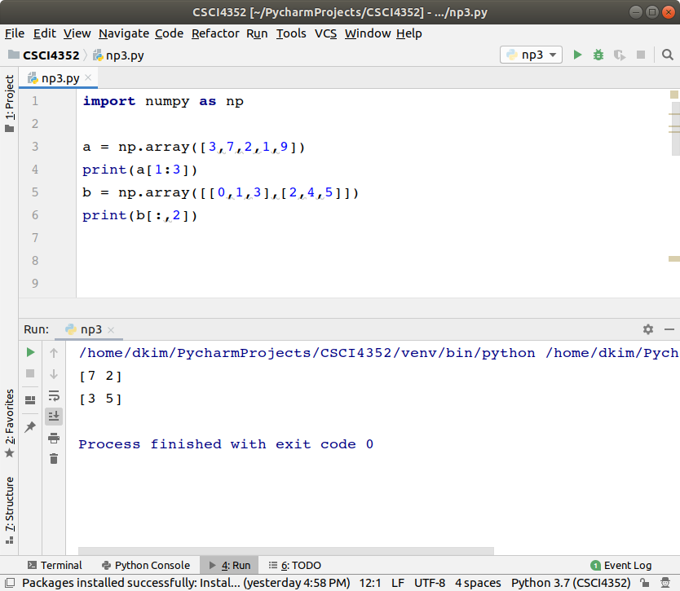
Slicing

Slide 14
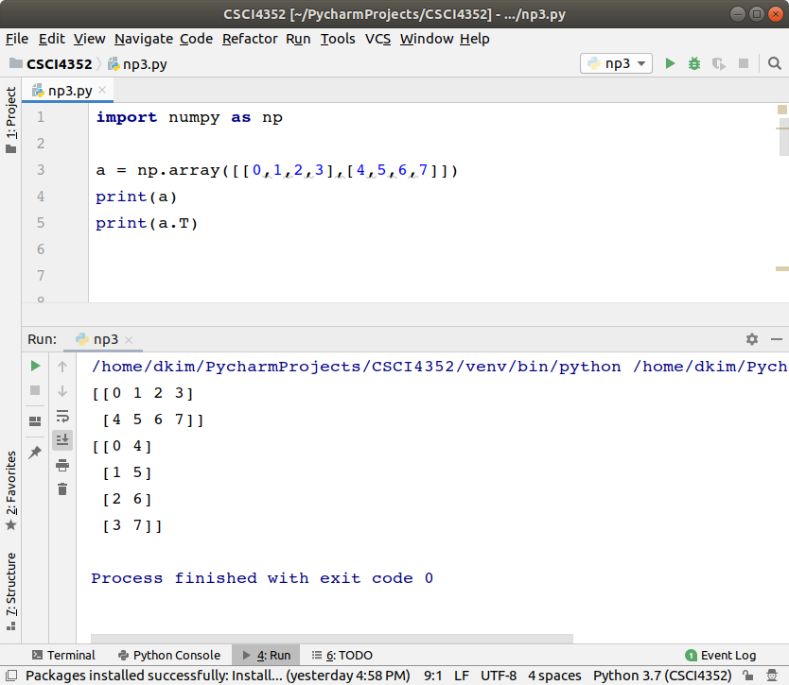
Transpose

Slide 15
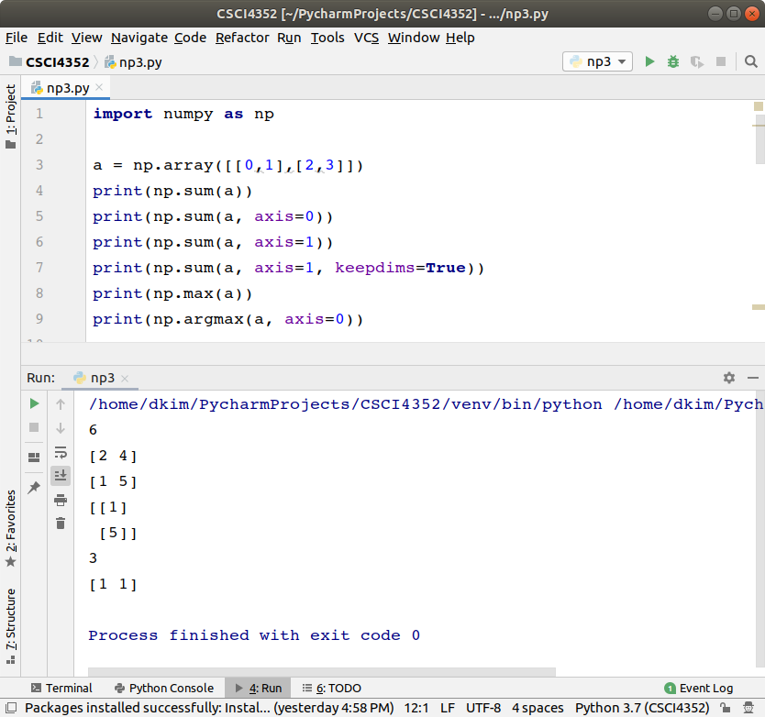
Numpy functions

Slide 16
Lab 2 - 2
Run the example codes and capture screens with outputs.
Submit python files (.py or .ipynb) and captured images of outputs and codes in blackboard.

